Slide 1

BCA Ist Semester Introduction of Logic Circuit and Digital Design(ILCDD) Course Code: BCAC0003
Presented by:
Mr.Anuj Kumar
Assistant Professor, Dept. Of CEA
GLA University, Mathura

Slide 2
NAND Gate
Known as a “universal” gate because ANY digital circuit can be implemented with NAND gates alone.
To prove the above, it suffices to show that AND, OR, and NOT can be implemented using NAND gates only.

Slide 3
Two-Level NAND Gate Implementation - Example
F (X,Y,Z) = Σm(0,6)
Express F in SOP form: F = X’Y’Z’ + XYZ’
Obtain the AND-OR implementation for F.
Add bubbles and inverters to transform AND-OR to NAND-NAND gates.

Slide 4
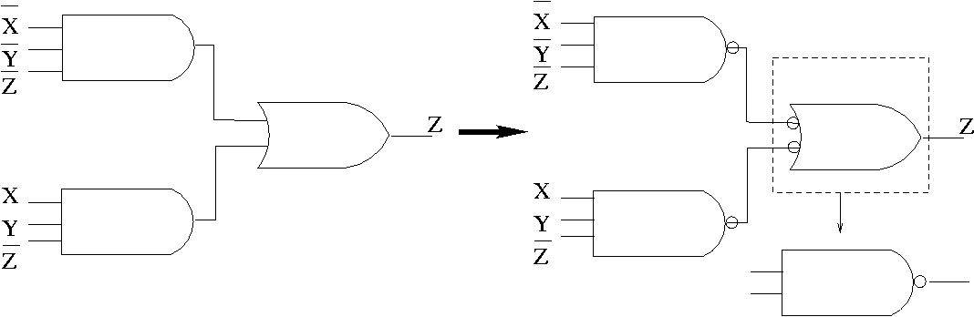
Example (cont.)
Two-level implementation with NANDs
F = X’Y’Z’ + XYZ’

Slide 5
Multilevel NAND Circuits
Starting from a multilevel circuit:
Convert all AND gates to NAND gates with AND-NOT graphic symbols.
Convert all OR gates to NAND gates with NOT-OR graphic symbols.
Check all the bubbles in the diagram. For every bubble that is not counteracted by another bubble along the same line, insert a NOT gate or complement the input literal from its original appearance.

Slide 6
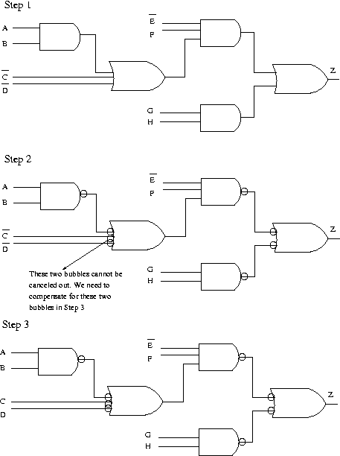
Example
Use NAND gates and NOT gates to implement Z=E’F(AB+C’+D’)+GH
AB
AB+C’+D’
E’F(AB+C’+D’)
E’F(AB+C’+D’)+GH

Slide 7
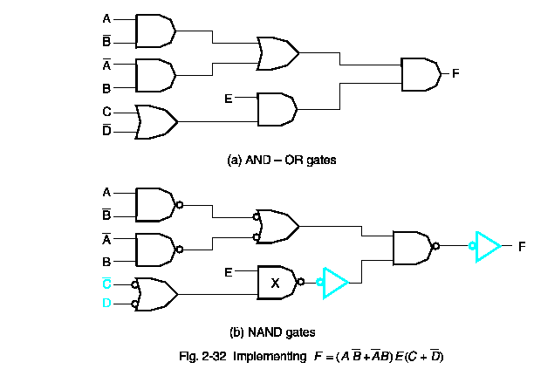
Yet Another Example!

Slide 8
NOR Gate
Also a “universal” gate because ANY digital circuit can be implemented with NOR gates alone.
This can be similarly proven as with the NAND gate.

Slide 9
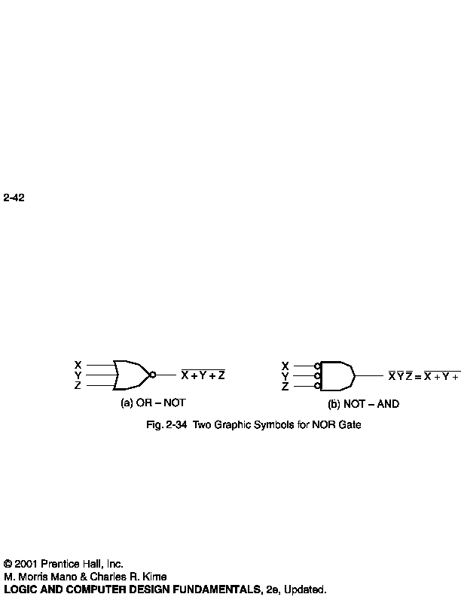
NOR Circuits
To easily derive a NOR implementation of a boolean function:
Find a simplified POS
POS is an OR-AND circuit
Change OR-AND circuit to a NOR circuit
Use the alternative symbols below

Slide 10
Two-Level NOR Gate Implementation - Example
F(X,Y,Z) = Σm(0,6)
Express F’ in SOP form:
F’ = Σm(1,2,3,4,5,7) = X’Y’Z + X’YZ’ + X’YZ + XY’Z’ + XY’Z + XYZ
F’ = XY’ + X’Y + Z
Take the complement of F’ to get F in the POS form: F = (F’)' = (X'+Y)(X+Y')Z'
Obtain the OR-AND implementation for F.
Add bubbles and inverters to transform OR-AND implementation to NOR-NOR implementation.

Slide 11
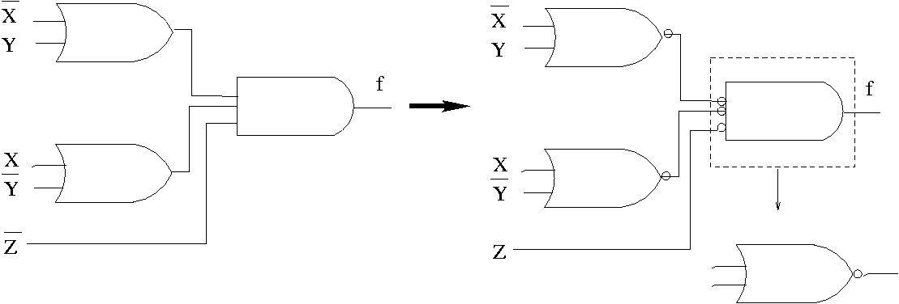
Example (cont.)
Two-level implementation with NORs
F = (F’)' = (X'+Y)(X+Y')Z'

